Slide 1
EDA CONTEST
SALES ANALYSIS PROJECT
Name: Jay Ganesh Charole
Email: jaycharole@gmail.com

Slide 2
CONTENTS
About the project
About the Data
Insights to find?
1
A detailed description about the project.
2
Introduction to data set that is been used for project.
3
What are the objectives and insights that are to be found out?
Visual analytics
Key Findings
Dashboard view
4
Different visuals and summaries to understand data well
5
Insights we found out according to various questions.
6
The view of dashboard that is been created

Slide 3
1
ABOUT THE PROJECT

Slide 4
ABOUT PROJECT
The project is data analytics project of EuroMart stores. In this project we are going to go through various aspects of data set and find the sales, profit, profit margin, discount and other things related to the sales analysis of the stores. The project will help the stores to modify the sales and help to improve their sales and marketing plan to regions, categories and segments where sales and profit are low.

Slide 5
2
ABOUT THE DATA

Slide 6
ABOUT DATA SET
The dataset is EuroStores Sales data which has various columns which gives information about different products their sales region, profits, discounts, shipping etc.

Slide 7
DETAILS OF DATASET
1
ORDER ID
The ORDER ID is the ID given to the order.
2
ORDER DATE
The ORDER DATE is the date when the product was ordered..
3
CUSTOMER NAME
The CUSTOMER NAME is the column in which name of the customer who has ordered is noted.
4
COUNTRY
The country in which customer reside.
5
STATE
The particular state of that country.

Slide 8
DETAILS OF DATASET
6
CITY
The city of that particular State.
7
REGION
The Region in which the customer stays i.e. either north, south, central
8
SEGMENTS
The SEGMENTS consist of various segments like HOME OFFICE, CONSUMER, CORPORATE.
9
SHIPPING MODE
Displays a particular shipping modes Economy, priority, etc.
10
CATEGORIES
The column displays various categories of the products.

Slide 9
DETAILS OF DATASET
11
SUB CATEGORIES
This shows various sub categories of categories.
12
PRODUCT NAME
The column displays names of the Product.
13
DISCOUNT
The column displays the Discount for the product.
14
SALES & PROFIT
The column displays the Sales & Profit for the product.
15
QUANTITY
The column displays quantity of the product

Slide 10
INSIGHTS TO
FIND OUT?
3

Slide 11
INSIGHTS TO BE FOUND?
1
Visual analytics and findings.
2
Overall analysis
3
Segment wise analysis
4
Region wise analysis
5
Country wise analysis

Slide 12
VISUAL ANALYTICS AND FINDINGS
4

Slide 13
SUMMARY OF DATA
Total sales
Total Profit
2.3M
283.2K
Total Quantity
30.4K

Slide 14
SUMMARY OF DATA
Total Transactions
Profit Margin
8.0K
12.1%
Total Customers
792

Slide 15
4.1
OVERALL ANALYSIS

Slide 16
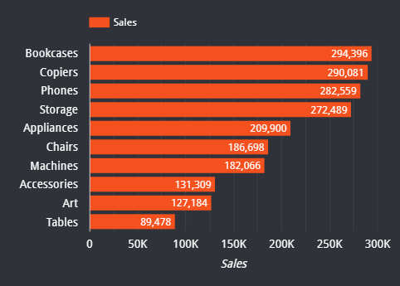
CATEGORY WISE OVERALL SALES ANALYSIS
Total Sales
2.3M
KEY INSIGHTS
The overall total sales are 2.3 M.
According to the graph Bookcases has the highest sales with 294,296. and the lowest is for Tables 89,478.

Slide 17
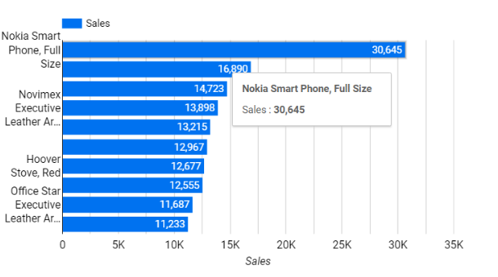
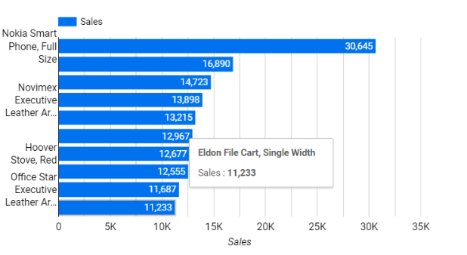
PRODUCT WISE OVERALL SALES ANALYSIS
KEY INSIGHTS
For the products the sales is highest for Nokia Smart Phone, Full size and the sales is lowest for Eldon File Cart, Single width.

Slide 18
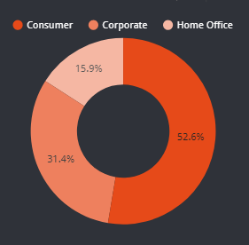
SEGMENT WISE OVERALL SALES ANALYSIS
KEY INSIGHTS
In segment wise sales analysis the highest percentage of sales is in Consumer segment i.e. 52.6% and the lowest percentage of sales is in Home Office i.e. 15.9%.

Slide 19
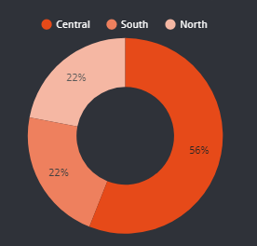
REGION WISE OVERALL SALES ANALYSIS
KEY INSIGHTS
For the region wise sales analysis. The highest is for Central region i.e. 56% and the both South and North shares same percentage of sales i.e. 22%.

Slide 20
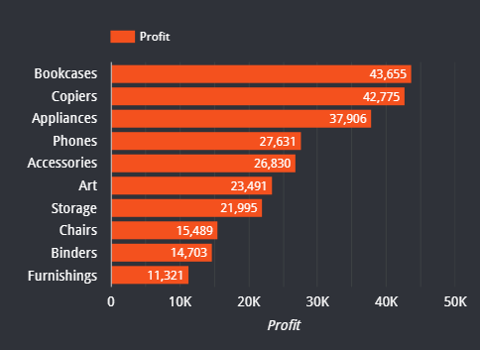
CATEGORY WISE OVERALL PROFIT ANALYSIS
Total Profit
283.2K
KEY INSIGHTS
The overall total profit are 283.2K
According to the graph Bookcases has the highest profit with 43,655 and the lowest is for Furnishings 11,321.

Slide 21
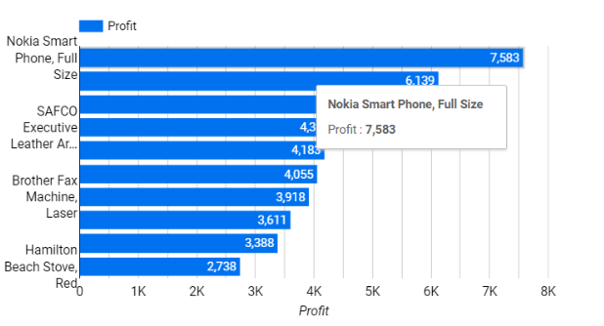
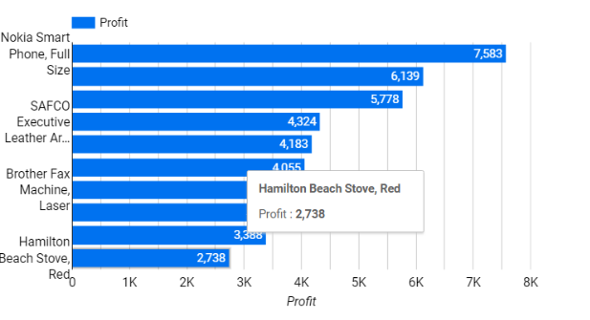
PRODUCT WISE OVERALL PROFIT ANALYSIS
KEY INSIGHTS
For the products the profit is highest for Nokia Smart Phone, Full size and the sales is lowest for Hamilton Beach Stove, Red.

Slide 22
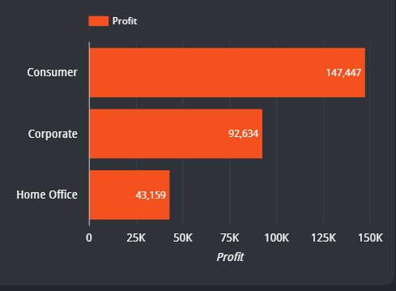
SEGMENT WISE OVERALL PROFIT ANALYSIS
KEY INSIGHTS
According to the visual the profit for consumer is highest and that of Home office is the lowest.

Slide 23
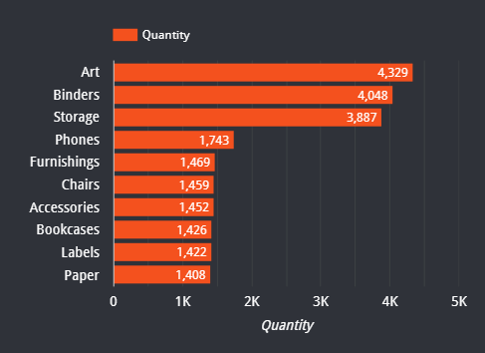
CATEGORY WISE OVERALL QUANTITY ANALYSIS
Total Quantity
30.4K
KEY INSIGHTS
The overall Total Quantity is 30.4 K.
According to the graph Art category has the highest quantity and the lowest is for Paper.

Slide 24
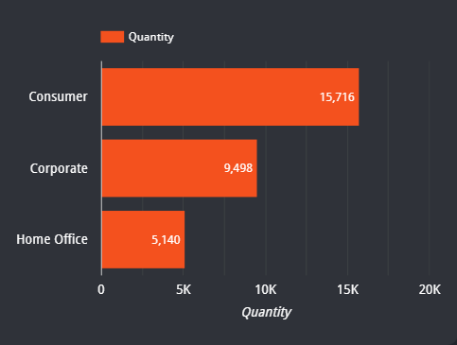
SEGMENT WISE OVERALL QUANTITY ANALYSIS
KEY INSIGHTS
According to the visual the Quantity for consumer is highest and that of Home office is the lowest.

Slide 25
SEGEMENT WISE ANALYSIS
4.2

Slide 26
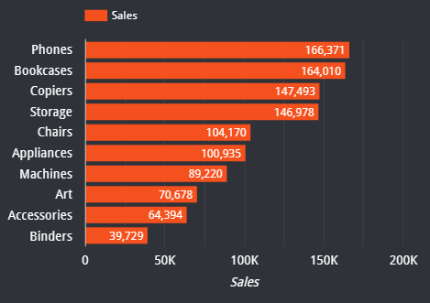
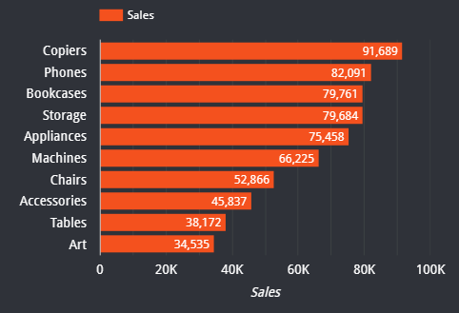
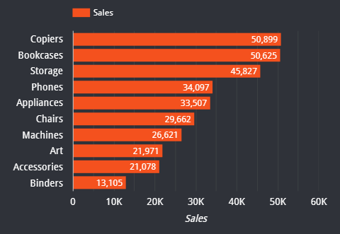
SALES ANALYSIS OF CATEGORIES IN VARIOUS SEGMENTS
HOME OFFICE
CORPORATE
CONSUMER
KEY INSIGHTS
According to the above visual, in Home Office segment the Phones is the category which has highest sales and Binders is the category which has lowest sales.
KEY INSIGHTS
According to the above visual, in Corporate segment the Copiers is the category which has highest sales and Art is the category which has lowest sales.
KEY INSIGHTS
According to the above visual, in Consumer segment the Copiers is the category which has highest sales and Binders is the category which has lowest sales.

Slide 27
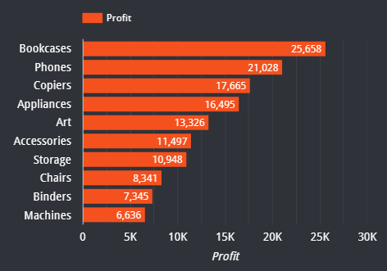
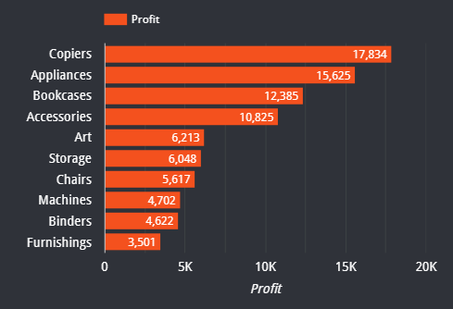
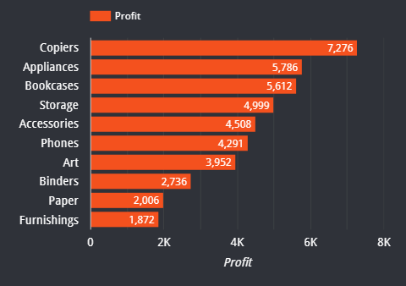
PROFIT ANALYSIS OF CATEGORIES IN VARIOUS SEGMENTS
HOME OFFICE
CORPORATE
CONSUMER
KEY INSIGHTS
According to the above visual, in Home Office segment the Bookcases is the category which has highest Profit and Machines is the category which has lowest profit.
KEY INSIGHTS
According to the above visual, in Corporate segment the Copiers is the category which has highest profit and Furnishing is the category which has lowest profit.
KEY INSIGHTS
According to the above visual, in Consumer segment the Copiers is the category which has highest profit and Furnishing is the category which has lowest profit.

Slide 28
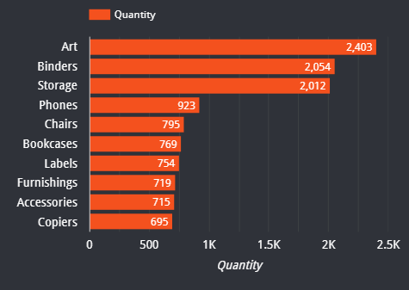
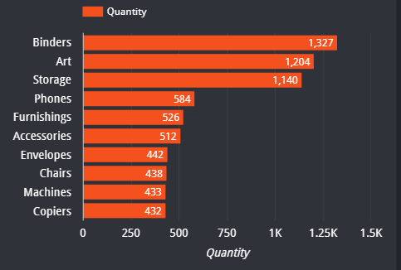
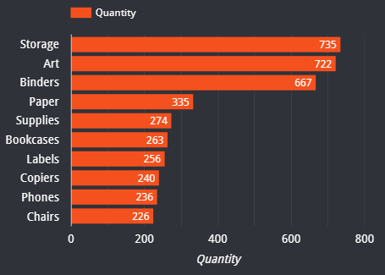
QUANTITY ANALYSIS OF CATEGORIES IN VARIOUS SEGMENTS
HOME OFFICE
CORPORATE
CONSUMER
KEY INSIGHTS
According to the above visual, in Home Office segment the Art is the category which has highest quantity and Copiers is the category which has lowest quantity.
KEY INSIGHTS
According to the above visual, in Corporate segment the Binders is the category which has highest quantity and Copiers is the category which has lowest quantity.
KEY INSIGHTS
According to the above visual, in Consumer segment the Storage is the category which has highest quantity and Chairs is the category which has lowest quantity.

Slide 29
REGION WISE ANALYSIS
4.3

Slide 30
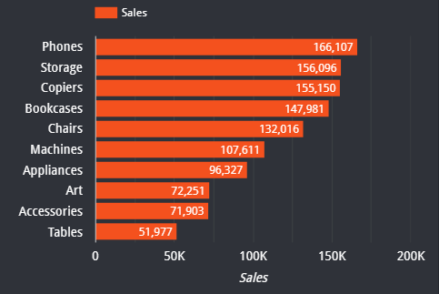
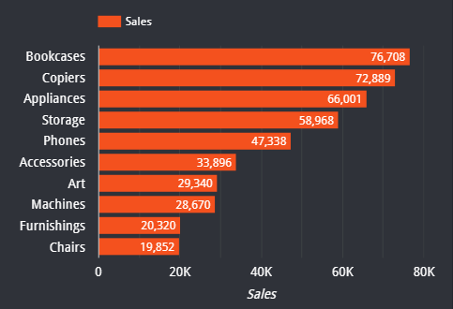
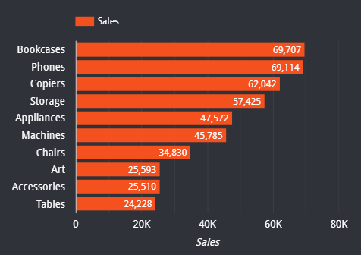
SALES ANALYSIS OF CATEGORIES IN VARIOUS REGIONS
CENTRAL
SOUTH
NORTH
KEY INSIGHTS
According to the above visual, in Central Region the Phones is the category which has highest sales and Tables is the category which has lowest sales.
KEY INSIGHTS
According to the above visual, in South Region the Bookcases is the category which has highest sales and Chairs is the category which has lowest sales.
KEY INSIGHTS
According to the above visual, in North Region the Bookcases is the category which has highest sales and Tables is the category which has lowest sales.

Slide 31
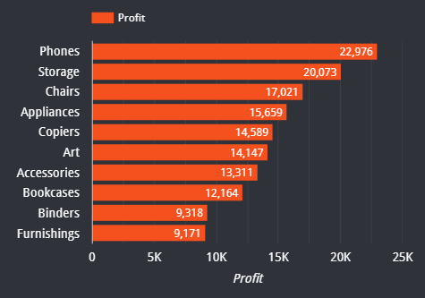
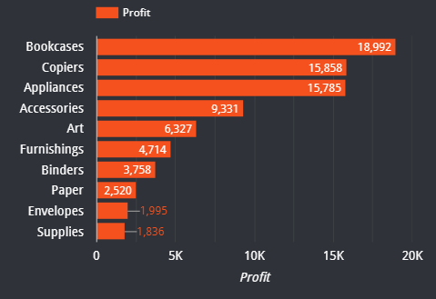
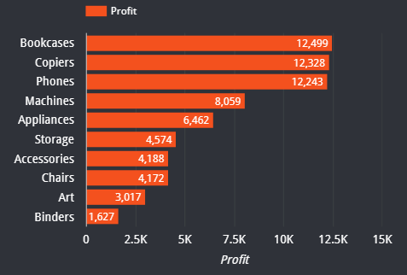
PROFIT ANALYSIS OF CATEGORIES IN VARIOUS REGIONS
CENTRAL
SOUTH
NORTH
KEY INSIGHTS
According to the above visual, in Central Region the Phones is the category which has highest profit and Furnishing is the category which has lowest profit.
KEY INSIGHTS
According to the above visual, in South Region the Bookcases is the category which has highest profit and Supplies is the category which has lowest profit.
KEY INSIGHTS
According to the above visual, in North Region the Bookcases is the category which has highest profit and Binders is the category which has lowest profit.

Slide 32
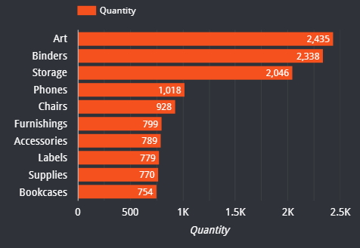
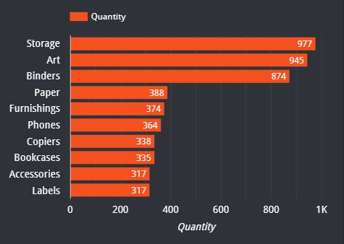
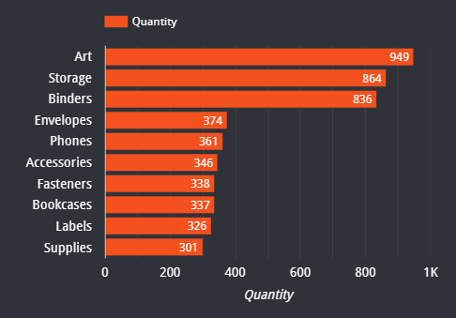
QUANTITY ANALYSIS OF CATEGORIES IN VARIOUS REGIONS
CENTRAL
SOUTH
NORTH
KEY INSIGHTS
According to the above visual, in Central Region the Art is the category which has highest quantity and Bookcases is the category which has lowest quantity.
KEY INSIGHTS
According to the above visual, in South Region the Storage is the category which has highest quantity and Labels is the category which has lowest quantity.
KEY INSIGHTS
According to the above visual, in North Region the Art is the category which has highest quantity and Supplies is the category which has lowest quantity.

Slide 33
4.4
COUNTRY ANALYSIS

Slide 34
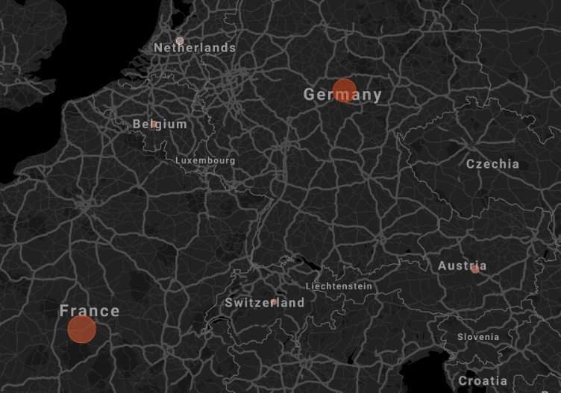
SALES AND PROFIR ANALYSIS ACROSS
VARIOUS COUNTRIES
No | Country | Sales | Profit
1 | Germany | 6,09,683 | 70,067
2 | France | 4,88,681 | 86,279
3 | Netherlands | 70,213 | -37,188
4 | Switzerland | 24,874 | 7,234
5 | Belgium | 43,200 | 9,912
6 | Austria | 79,382 | 21,332
KEY INSIGHTS
From the above table we can say that sales is highest in Germany and lowest in Switzerland.
Whereas the Profit is highest in France and lowest in Netherlands.

Slide 35
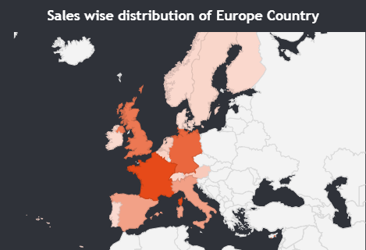
SALES ANALYSIS IN EUROPEAN COUNTRIES
KEY INSIGHTS
The sales is highest in France whereas in Ireland it is lowest
Ireland
Sales: 15,998
France
Sales: 609,683

Slide 36
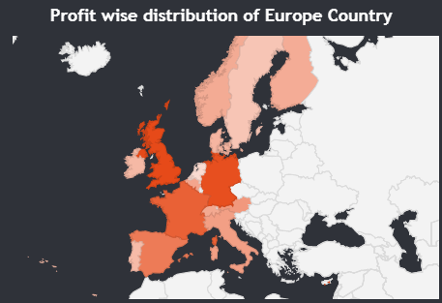
PROFIT ANALYSIS IN EUROPEAN COUNTRIES
KEY INSIGHTS
According to the visual the Profit is Highest in United Kingdom (U.K) and Least in Netherlands.
Netherlands
Profit: -37,188
United Kingdom
Profit: 90,382

Slide 37
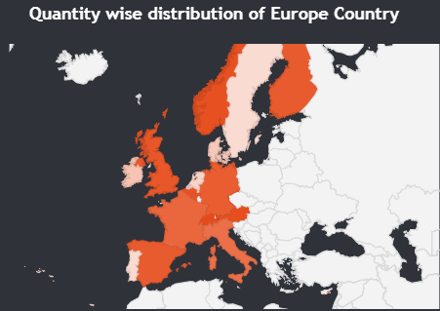
PROFIT MARGIN ANALYSIS IN
EUROPEAN COUNTRIES
KEY INSIGHTS
The Profit Margin is highest in Norway whereas it is lowest in Netherlands.
Norway
Sales: 0.25
Netherlands
Profit Margin: -0.53

Slide 38
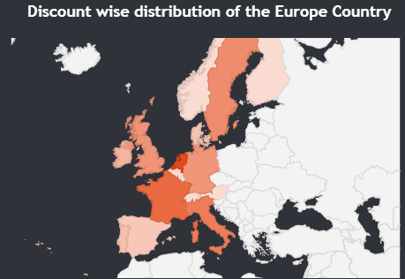
DISCOUNT ANALYSIS IN EUROPEAN COUNTRIES
KEY INSIGHTS
The Discount is highest in Netherlands whereas it is lowest in Finland.
Finland
Discount: 0
Netherlands
Discount: 188.9

Slide 39
4.5
OTHER ANALYSIS

Slide 40
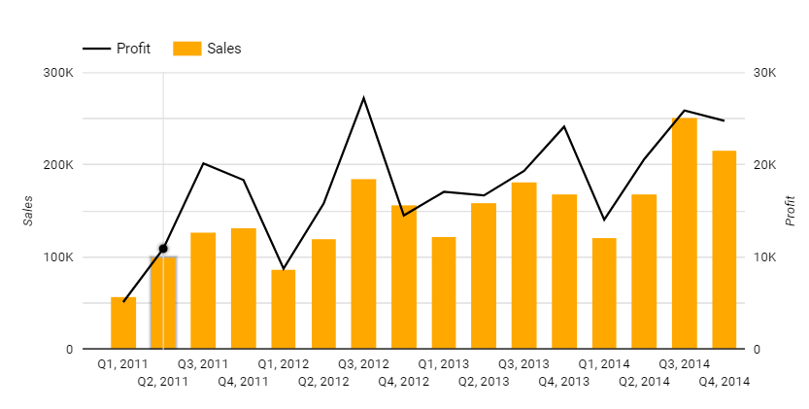
QUATERLY SALES AND PROFIT ANALYSIS
KEY INSIGHTS
According to above visual the sales in highest in 3rd Quarter of 2014 and lowest in 1st Quarter of 2011.
Profit is highest in 3rd Quarter of 2012 whereas lowest in the 1st Quarter of 2011.

Slide 41
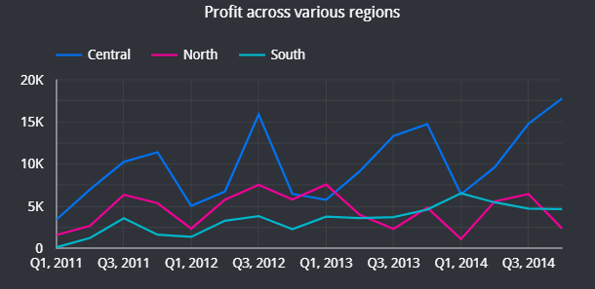
PROFIT ACROSS VARIOUS REGIONS
KEY INSIGHTS
According to the above visual
Central region has the highest profit in 3rd quarter of 2014 and lowest is in 1st quarter of 2012.
The North region has the highest profit in 1st Quarter of 2013 and lowest in 1st Quarter of 2014.
South region has the highest profit in 1st Quarter of 2014 and lowest in 1st Quarter of 2011.

Slide 42
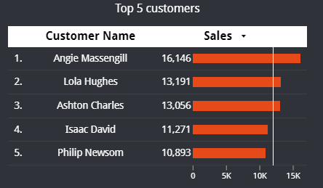
TOP 5 CUSTOMERS
KEY INSIGHTS
From the above visual we can see that the customer which as the highest sale who has crossed 11K mark is Angie Massengill and the lowest you has not crossed the 11K mark is Phillip Newsom.

Slide 43
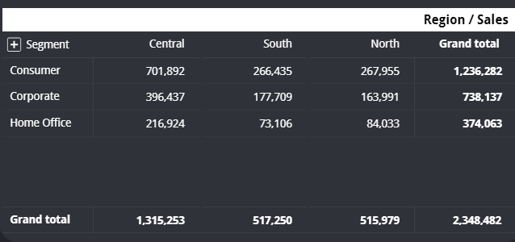
REGION VS SEGMENT SALES ANALYSIS
KEY INSIGHTS
The above pivot table shows the sales in various regions across various segments. From the visual we can make out that Central region has the highest sales.

Slide 44
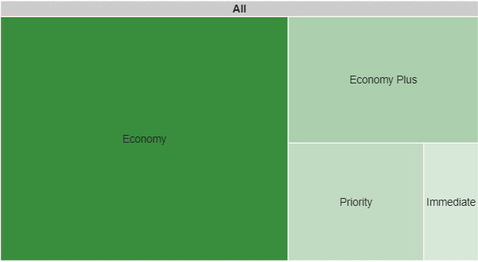
REGION VS SEGMENT SALES ANALYSIS
KEY INSIGHTS
The to the above visual the most used shipping mode is Economy whereas the least used shipping mode is Immediate according to sales.

Slide 45
5
KEY INSIGHTS

Slide 46
INSIGHTS TO BE FOUND?
1
Segments with highest sales has highest profit as well.
2
Nokia Smart phone is very famous and has huge profits.
3
Sales is highest in the consumer segments.
4
Sales is highest in central region.
5
From overall observation bookcases, phones, copiers has more sales but their quantity is comparatively less.

Slide 47
INSIGHTS TO BE FOUND?
6
Most people choose Economy shipping rather than immediate.
7
Where there is absolute no sales discount is very high.
8
Netherlands has lowest profit & sales.
9
Angle Massengile is the customer with highest sales.
10
Central region has the highest sales.

Slide 48
6
DASHBOARD

Slide 49
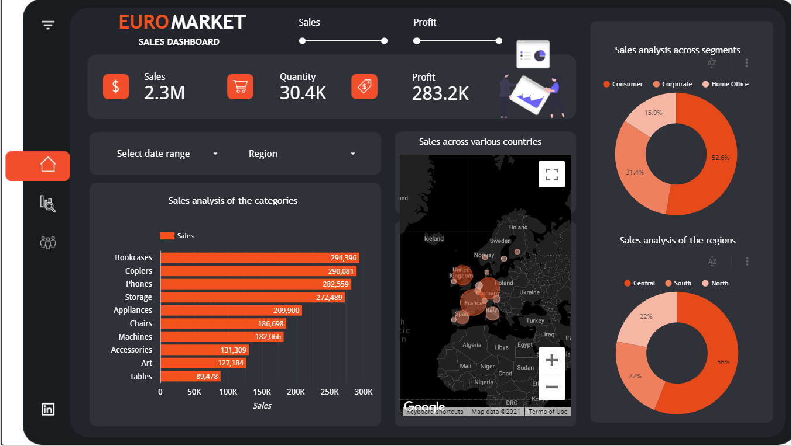
DASHBOARD PAGES VIEW

Slide 50
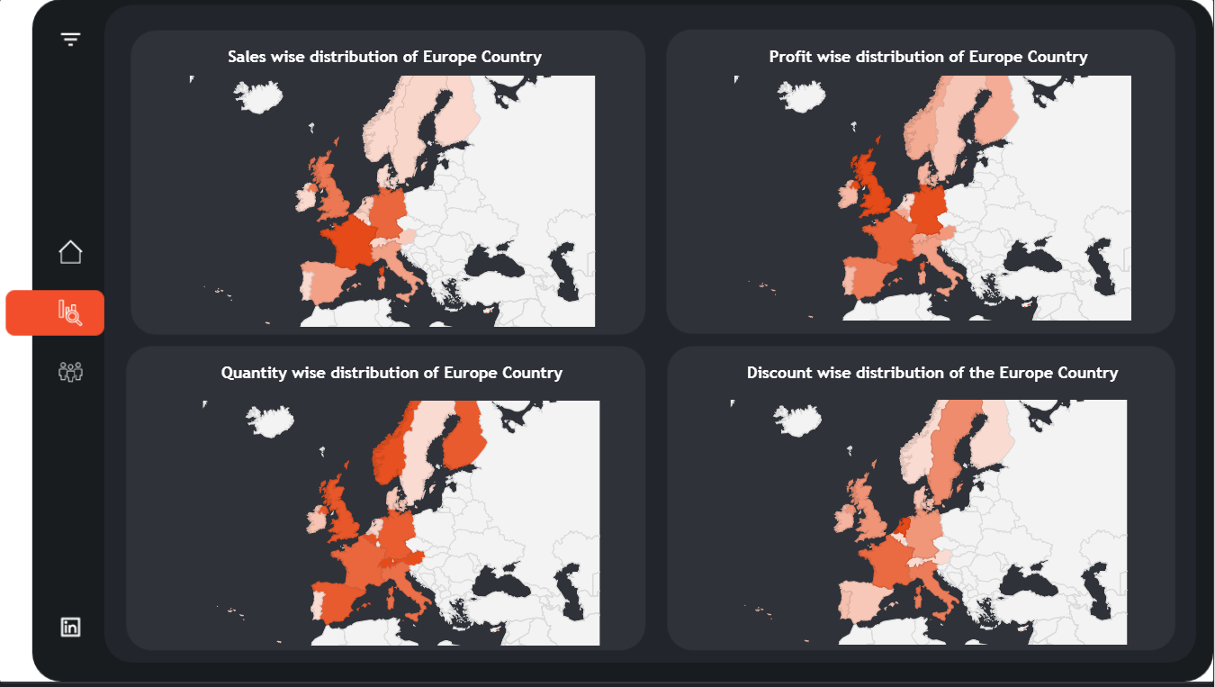
DASHBOARD PAGES VIEW

Slide 51
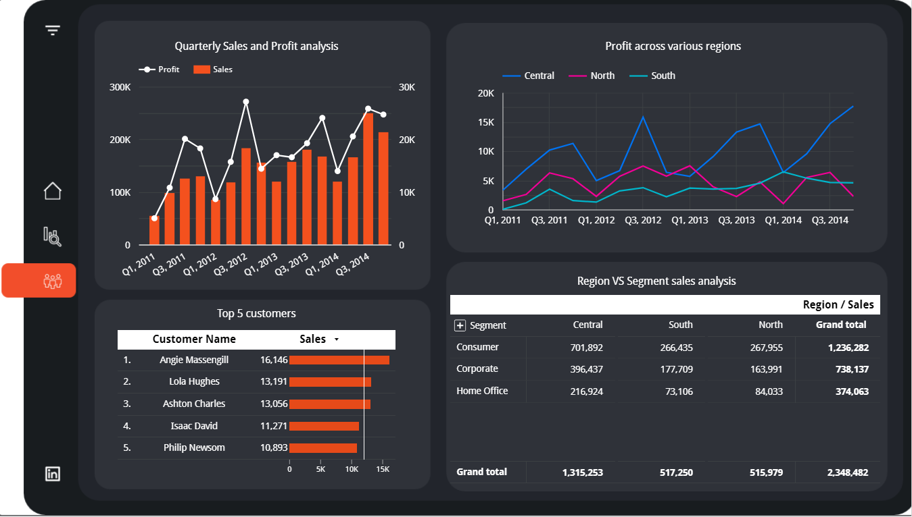
DASHBOARD PAGES VIEW

Slide 52

/
THANK YOU !
A very special thanks to Satyajit Sir for organizing this amazing contest.
CONTACT AND SOCIAL LINKS
Email: jaycharole@gmail.com
Contact: 9892968944

